Slide 1

My top 5 countries in gapminder
Sindy Saintclair

Slide 2
My Top 5 Countries
Haiti
Israel
United States
Lebanon
Morocco

Slide 3
Which country of the five you chose has the lowest and highest per capita GDP in 1952? In 2007?
My Top 5 Countries from Highest to Lowest per capita GDP in 1952
United States of America | 13,990.4821
Lebanon | 4,834.8041
Israel | 4,086.5221
Haiti | 1,840.3669
Morocco | 1,688.2036
1952
USA | Morocco
VS.
2007
USA | Haiti
My Top 5 Countries from Highest to Lowest per capita GDP in 2007
United States of America | 42,951.6531
Israel | 25,523.2771
Lebanon | 10,461.0587
Morocco | 3,820.175
Haiti | 1,201.6372
percapitaGDP <- gapminder %>% filter(year == 1952) %>% arrange(desc(pop)) OR percapitaGDP <- gapminder %>% filter(year == 2007) %>% arrange(desc(pop))
percapitaGDP

Slide 4
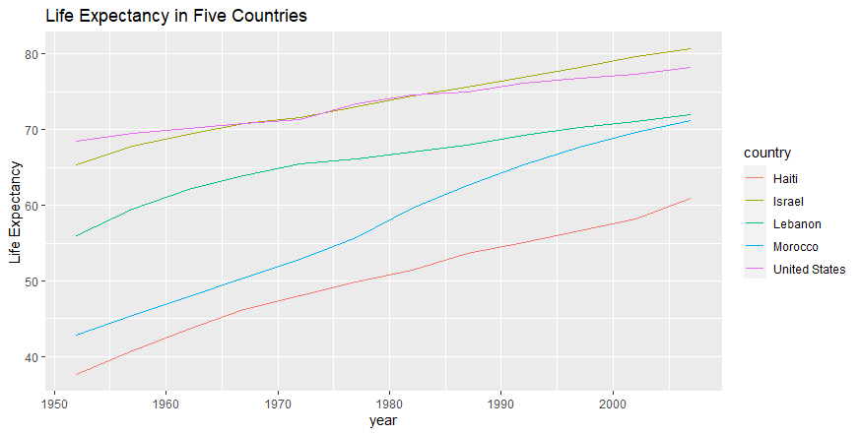
Describe the variations in life expectancy between the countries.
As you can see from the graph, all countries experienced an increase in life expectancy ranging from 10 to 28 years in increase, with Morocco experiencing the highest jump in life expectancy increase. The United States experienced the smallest increase in life expectancy.

Slide 5
For what years is the life expectancy for my five countries above the median life expectancy for the entire gapminder data frame?
The life expectancy median for the entire gapminder data frame was 60.7125. It was found that my top 5 countries all held life expectancies above the median life expectancy for the entire gap minder data frame in the following years:
Haiti – 2007
Israel – 1952 to 2007
Lebanon – 1962 to 2007
Morocco – 1987 to 2007
United States – 1952 to 2007

Slide 6
Thank you
To conclude, the life expectancies in the nations that I chose to base my data from all experienced at least a 10-year increase over the course of fifty years.

